Slide 1
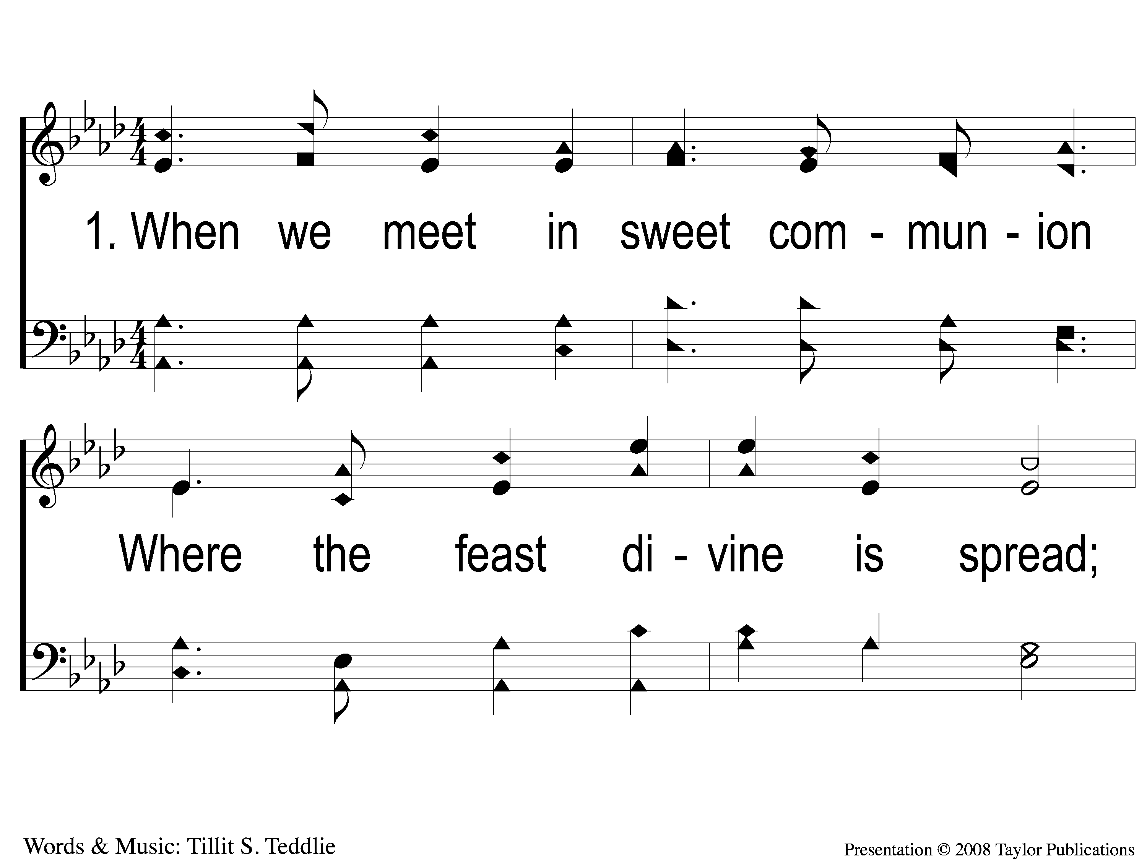
1-1 The Lord's Supper
The Lord's Supper
105

Slide 2
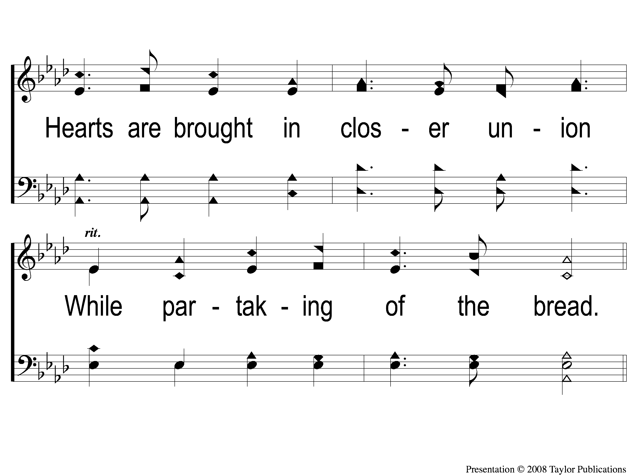
1-2 The Lord's Supper
The Lord's Supper
105

Slide 3
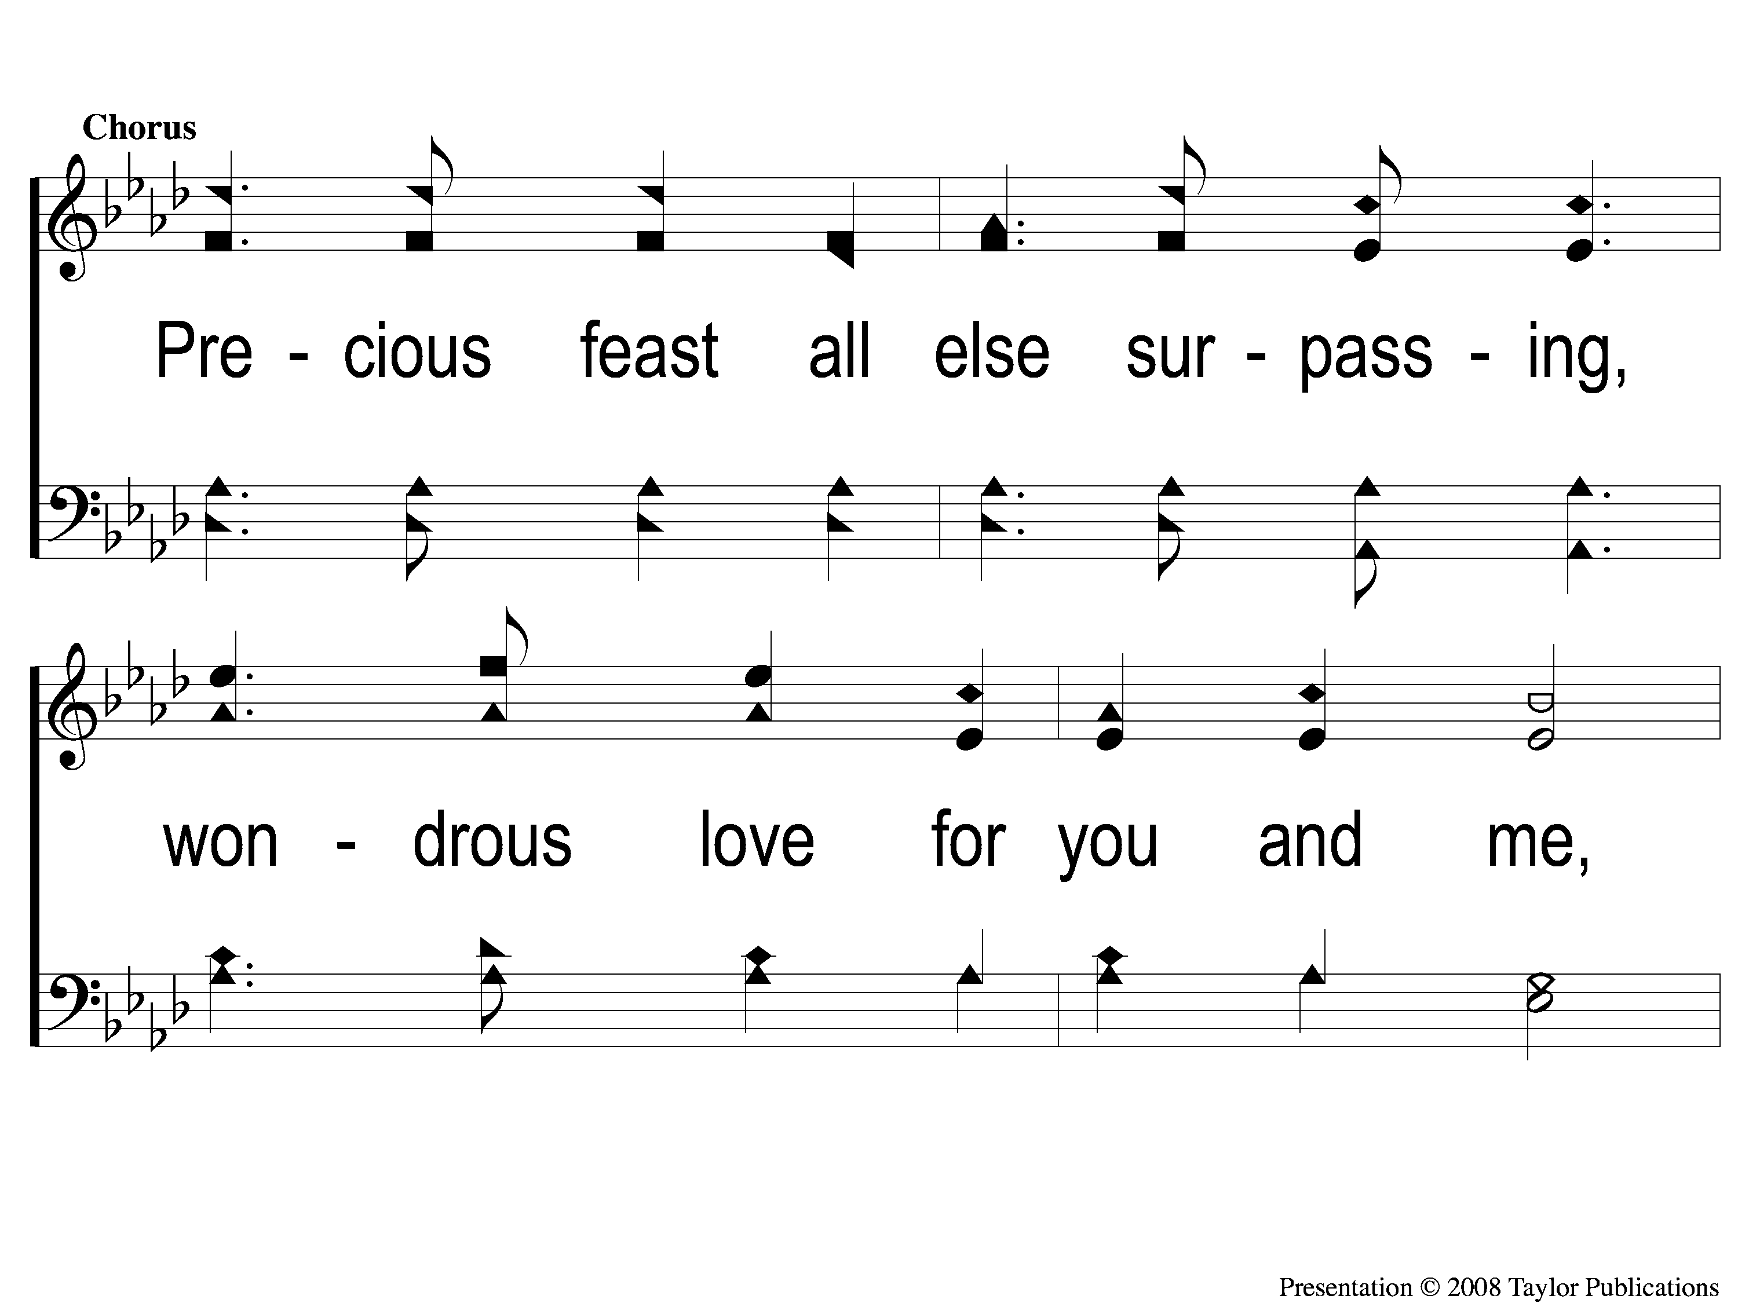
C-1 The Lord's Supper
The Lord's Supper
105

Slide 4
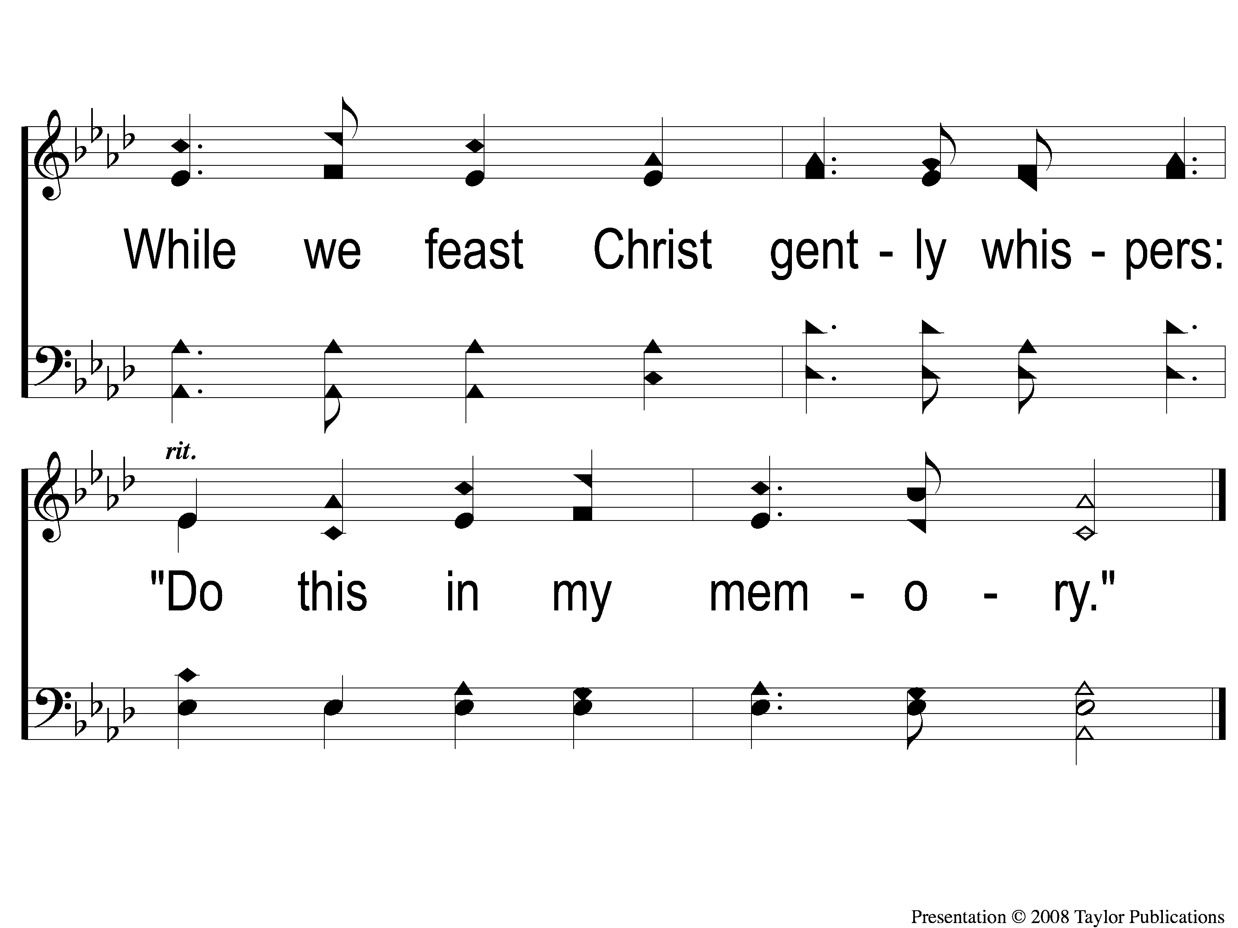
C-2 The Lord's Supper
The Lord's Supper
105

Slide 5
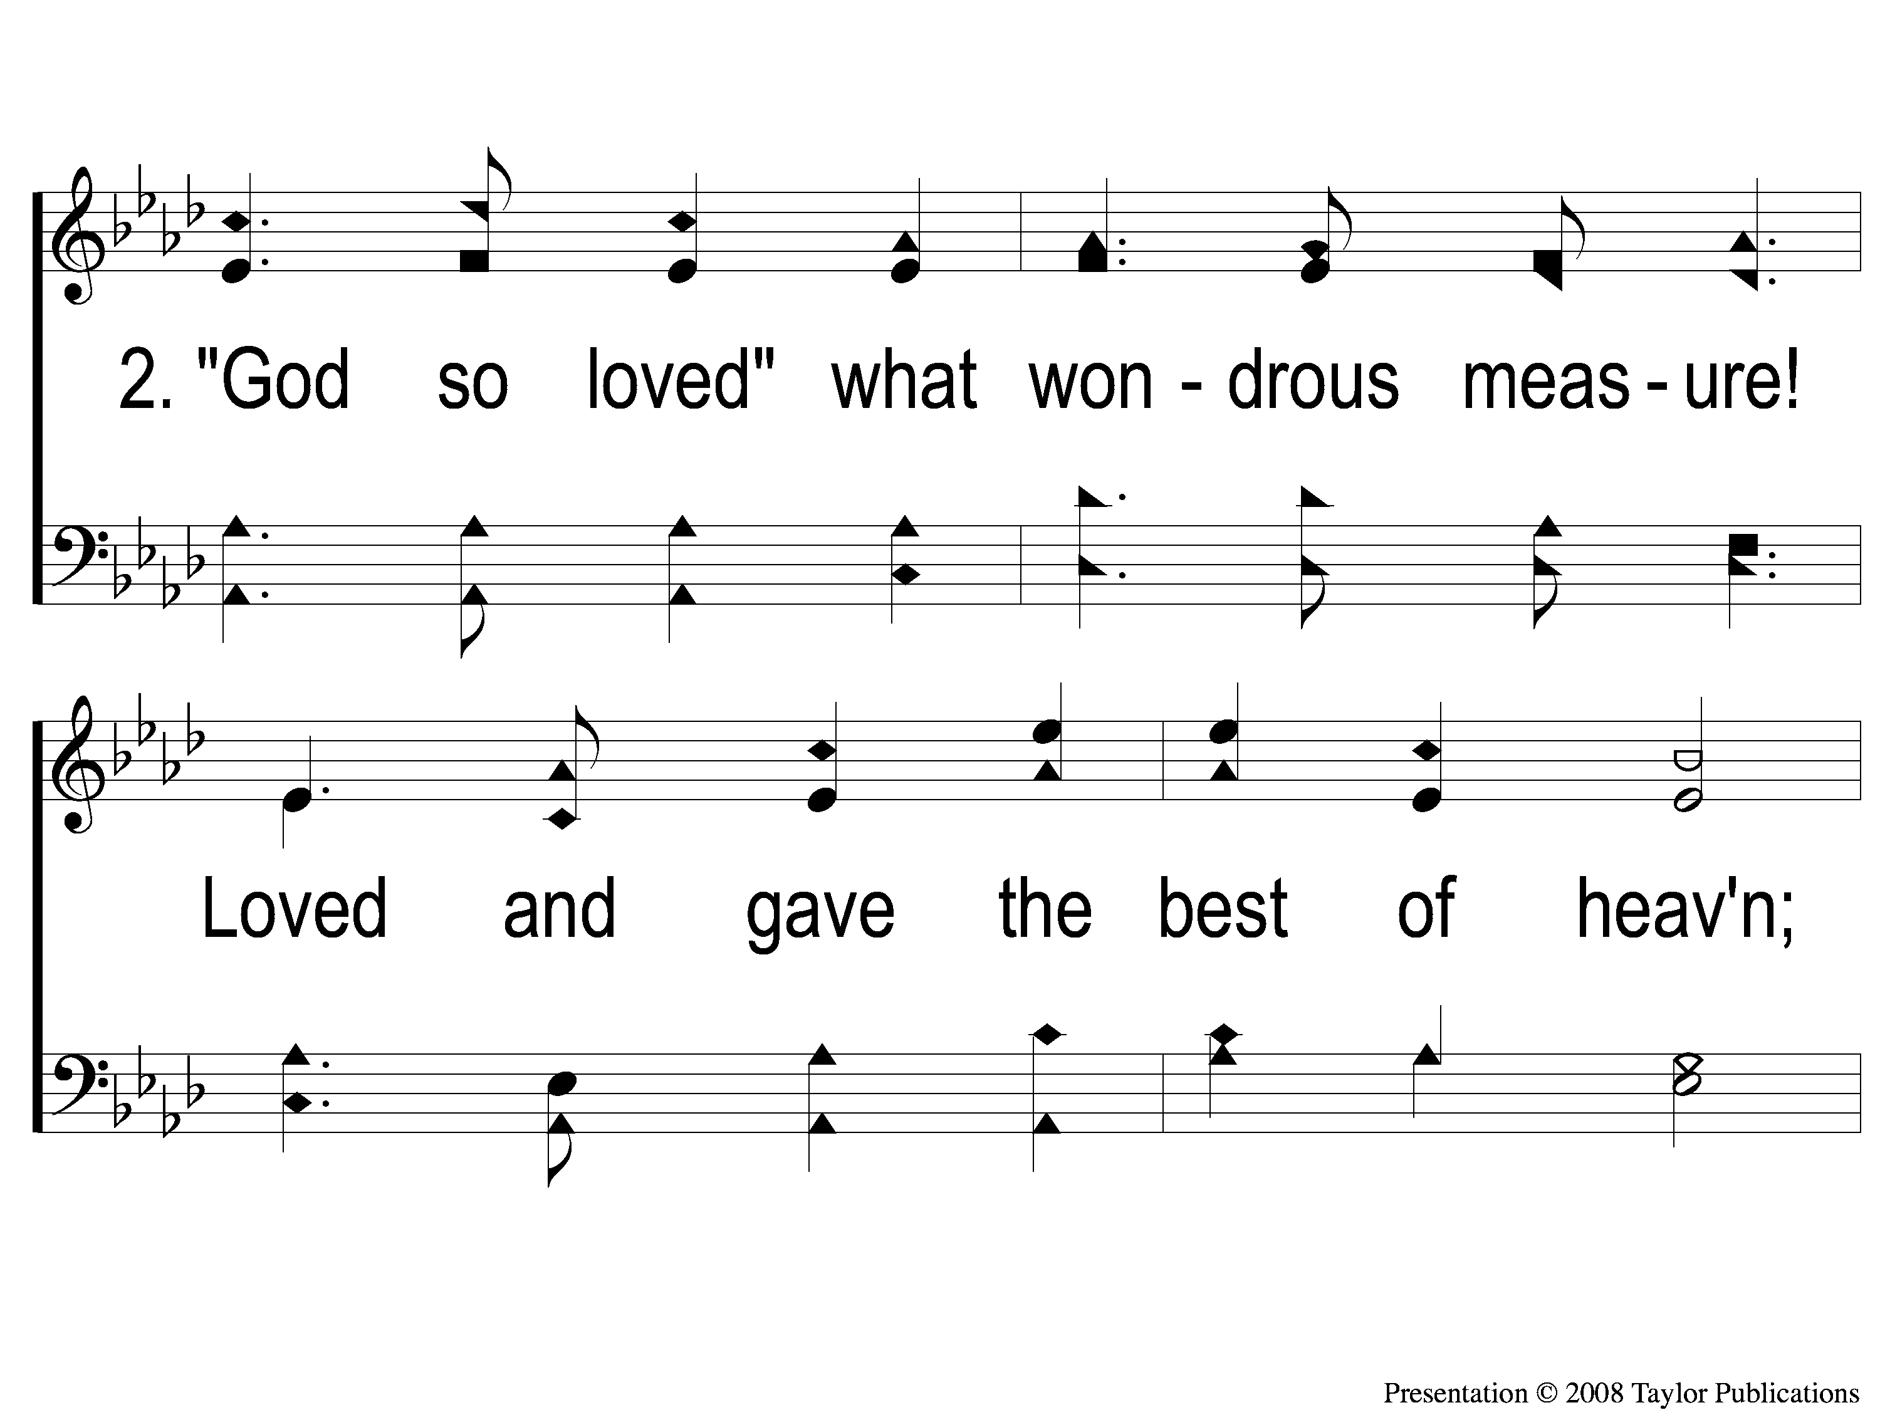
2-1 The Lord's Supper
The Lord's Supper
105

Slide 6
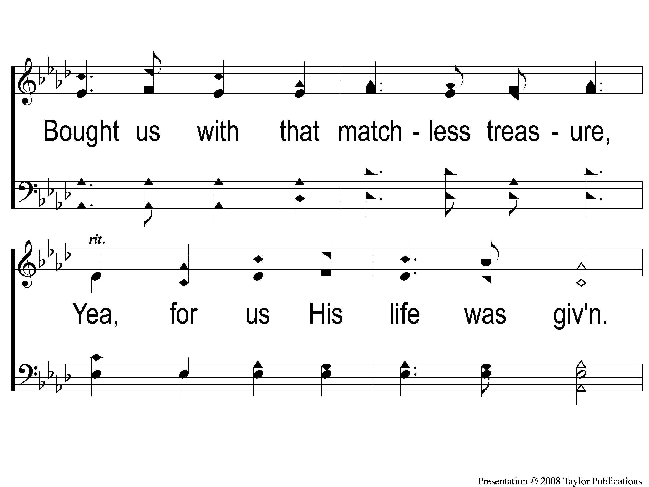
2-2 The Lord's Supper
The Lord's Supper
105

Slide 7
C-1 The Lord's Supper
The Lord's Supper
105

Slide 8
C-2 The Lord's Supper
The Lord's Supper
105

Slide 9
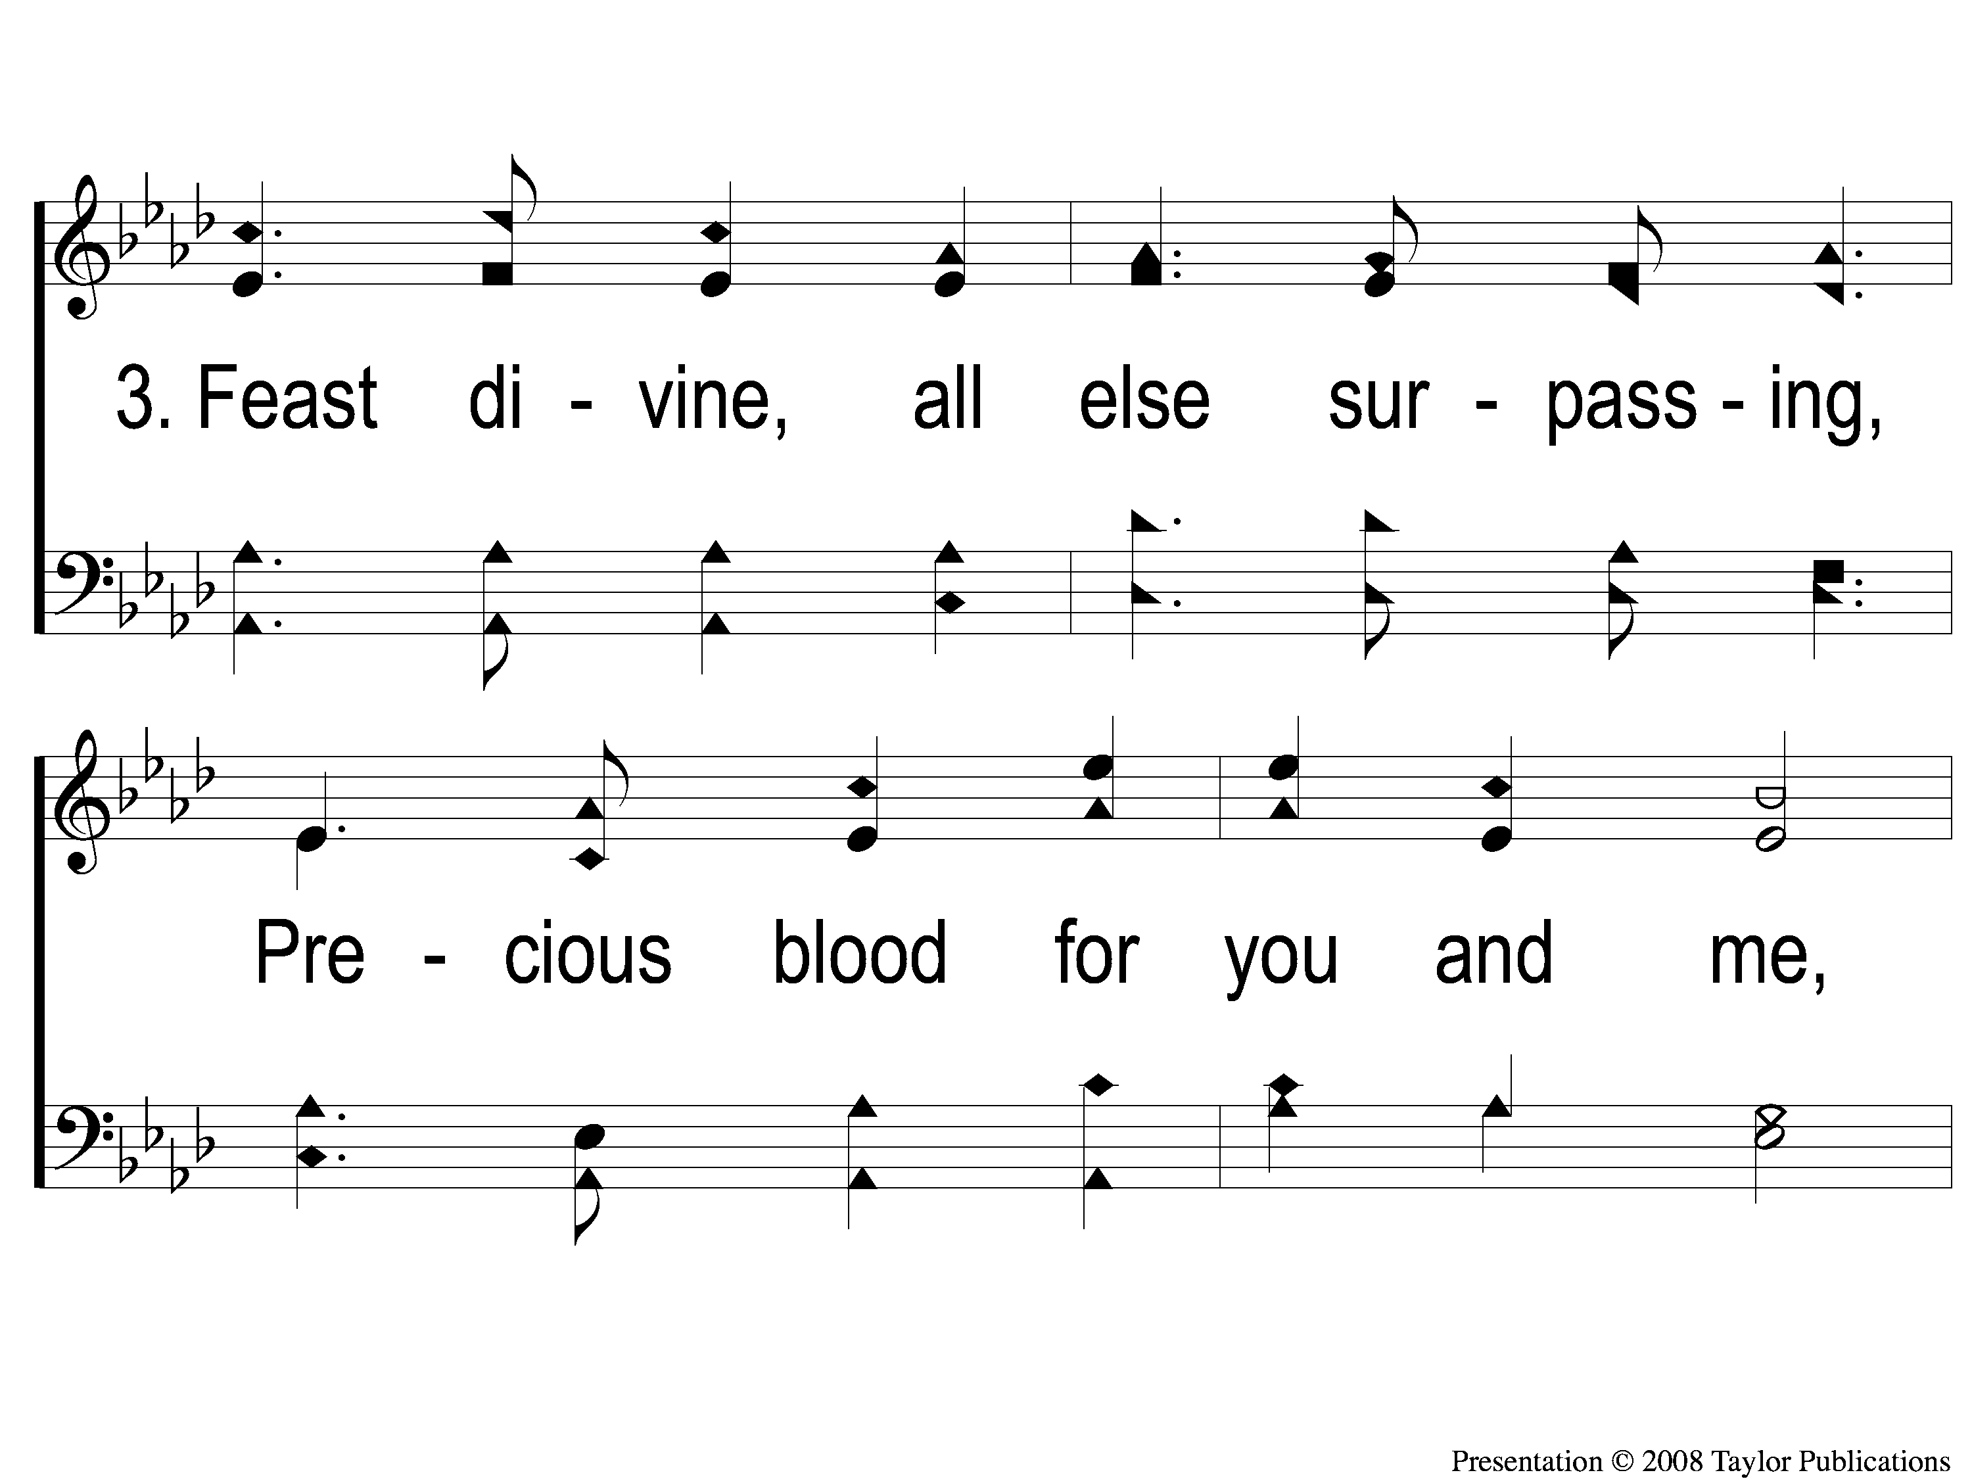
3-1 The Lord's Supper
The Lord's Supper
105

Slide 10
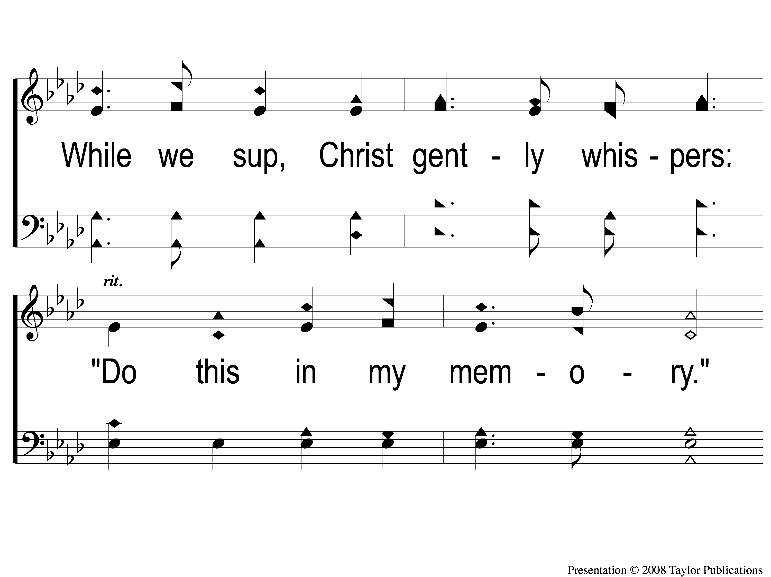
3-2 The Lord's Supper
The Lord's Supper
105

Slide 11
C-1 The Lord's Supper
The Lord's Supper
105

Slide 12
C-2 The Lord's Supper
The Lord's Supper
105

